Slide 1


Customer Segmentation
An RFM+ based clustering approach
Capstone Project 3
July 2021
by Adam Passmore

Slide 2
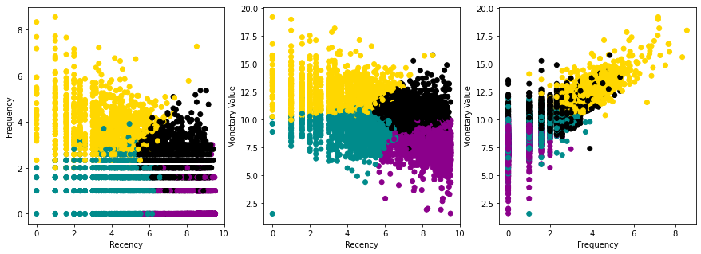
Why Customer Segmentation?
Using RFM Analysis
Who are our customers?
How do our customers behave?
Can we create strategies of marketing and/or customer service that match the preferences of certain customers?
Recency, Frequency, Monetary Value
RFM+: Other features calculated from transactions
Percentile Analysis vs. Clustering Techniques

Slide 3

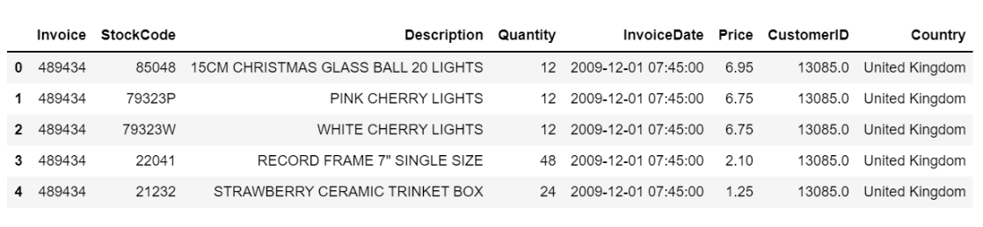
Data Cleaning
Online Retail II Data Set
http://archive.ics.uci.edu/ml/datasets/Online+Retail+II
Notes:
clean dataset contains records from Dec 01, 2009 to Dec 09, 2011, with over 44,000 unique orders (including cancellations) from 5,841 unique customers across 41 different countries.

Slide 4
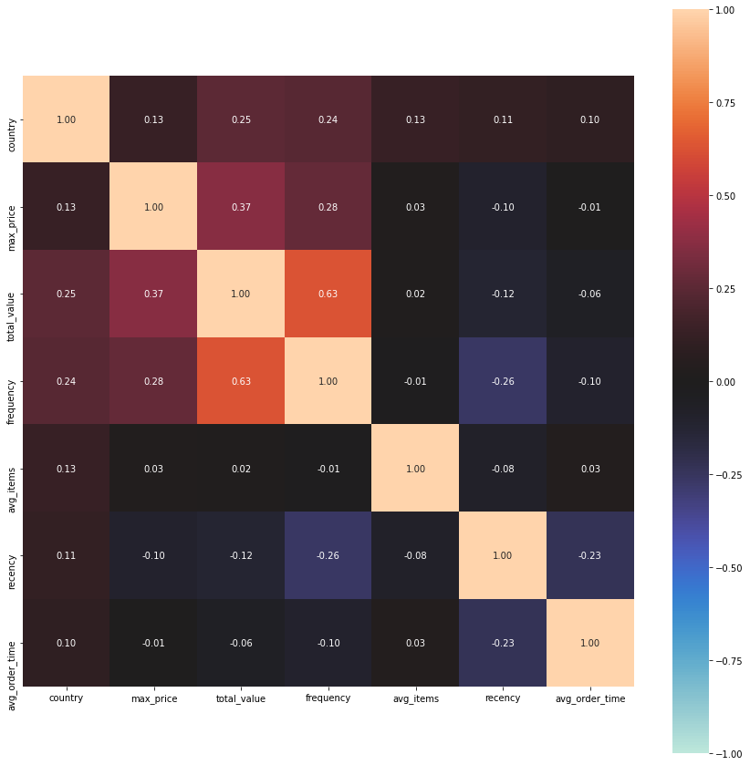
Feature Engineering
Recency
Frequency
Monetary Value
Average Order Time
Maximum Price
Average Items
Country (encoded as Region)
Notes:
Describe calculation for each new feature calculated from full dataset, aggregated into orders by Invoice # and then by Customer ID.

Slide 5
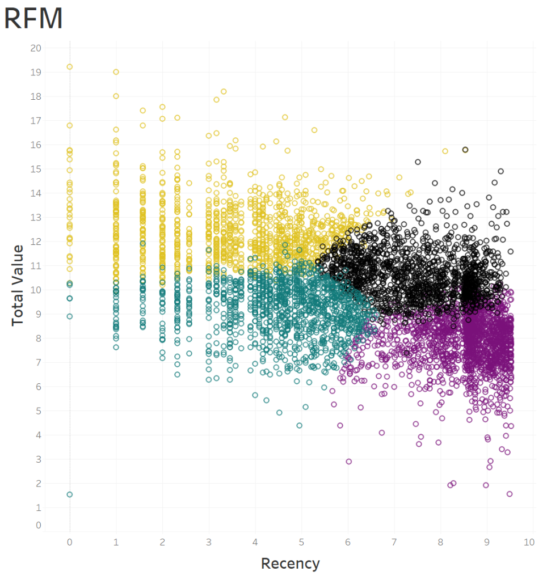
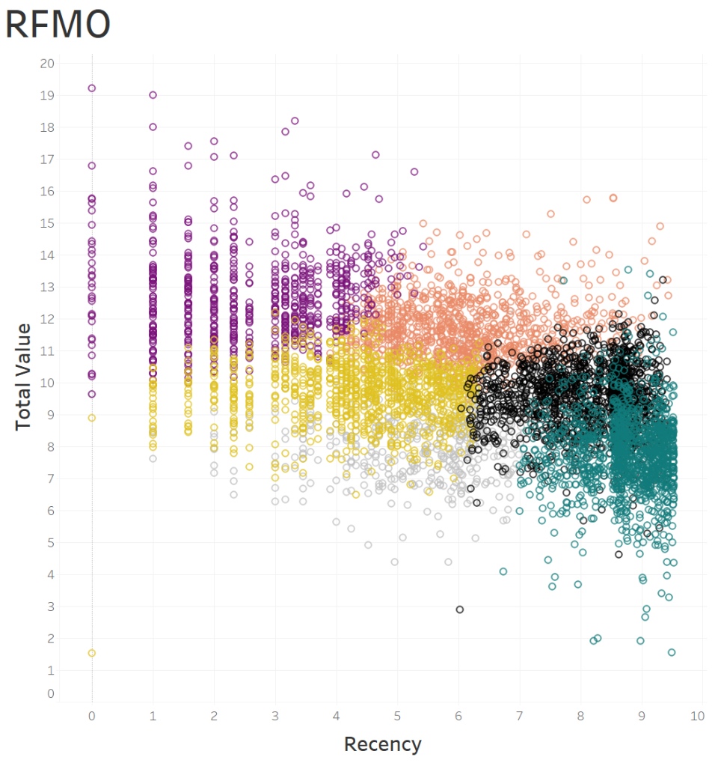
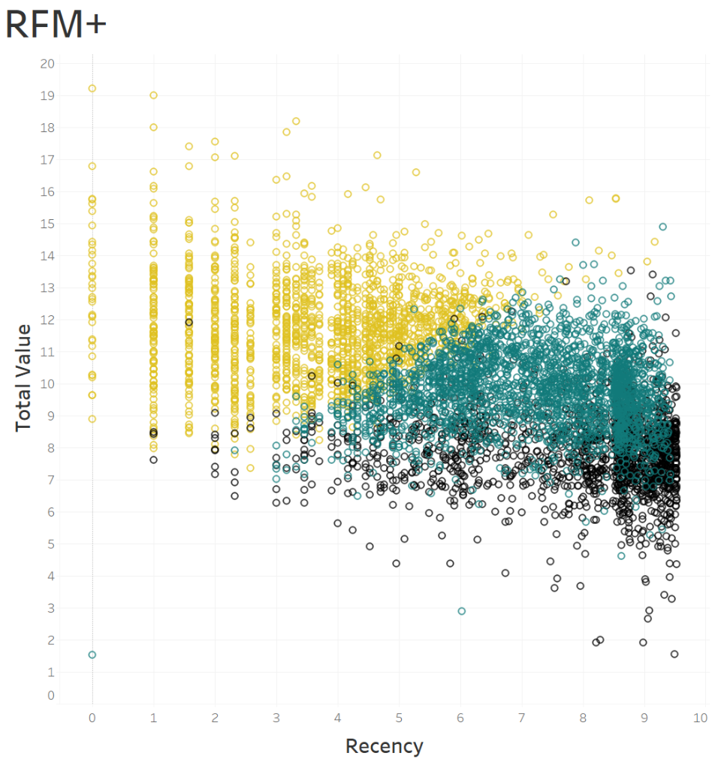
Results
Three viable models
1 - RFM: 4 segments
(silhouette score = 0.364)
2 - RFMO: 6 segments
(silhouette score = 0.356)
3 - RFM+: 3 segments
(silhouette score = 0.367)
Notes:
Presented in increasing order of dimensionality (3D, 4D, 8D). Which model to use mainly depends on how many different targeted strategies the company wants to employ.

Slide 6
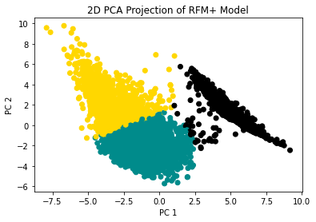
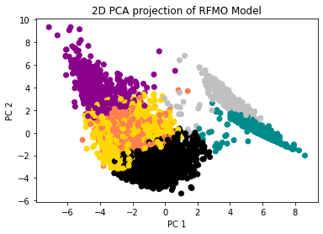
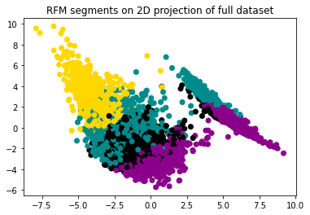
Why 3 Models?
Notes:
We can see that the full dataset has a significant separation of the data - it turns out this is due to customers with low or 0 average order time. The RFM only model does not capture this cluster well - the RFMO is meant to reconcile both. However, note that whether the order time feature is truly important is debatable.
Also mention other models that were tried: Agglomerative clustering, Spectral clustering, and DBSCAN. K-Means consistently produced the best results.

Slide 7
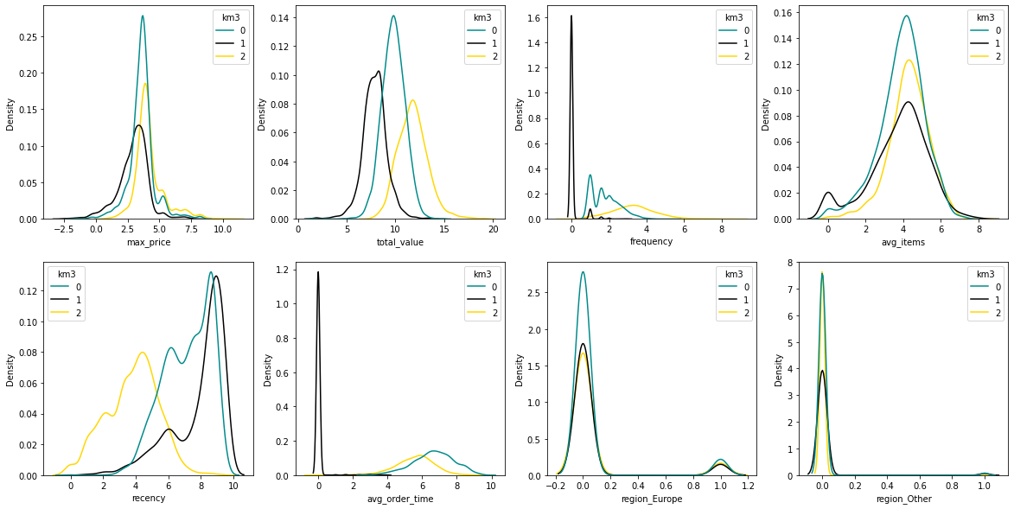
RFM+
Old Friends/At Risk
One & Done
Loyal Customers
Notes:
Because most of the additional dimensions included in this model seem to have little relevance (max_price, avg_items, region), this is not the recommended model. However, it does serve a good use of dividing by Order Time and splitting the remaining data into recent/frequent/high value (yellow) vs. older/less frequent/mid value (teal).
This can simplify the strategizing into 2 or three targeted campaigns.

Slide 8
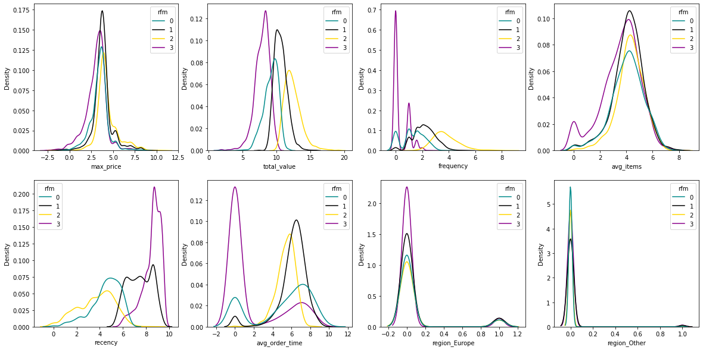
RFM
New/At Risk
Old Friends
Loyal Customers
Moved On
Notes:
The case for ignoring Avg_Order_Time: it’s a peculiar feature, where 0 indicates inactive customers, but 2-6 indicates really active customers, and above that is slow customers (perhaps ordering 2x/year or less). It can vary wildly if a customer has only a few purchases (think 2 orders in one week, then a third order one year later). In other words, even though it is not necessarily correlated with frequency, it is heavily dependent on it/magnifies its importance.

Slide 9
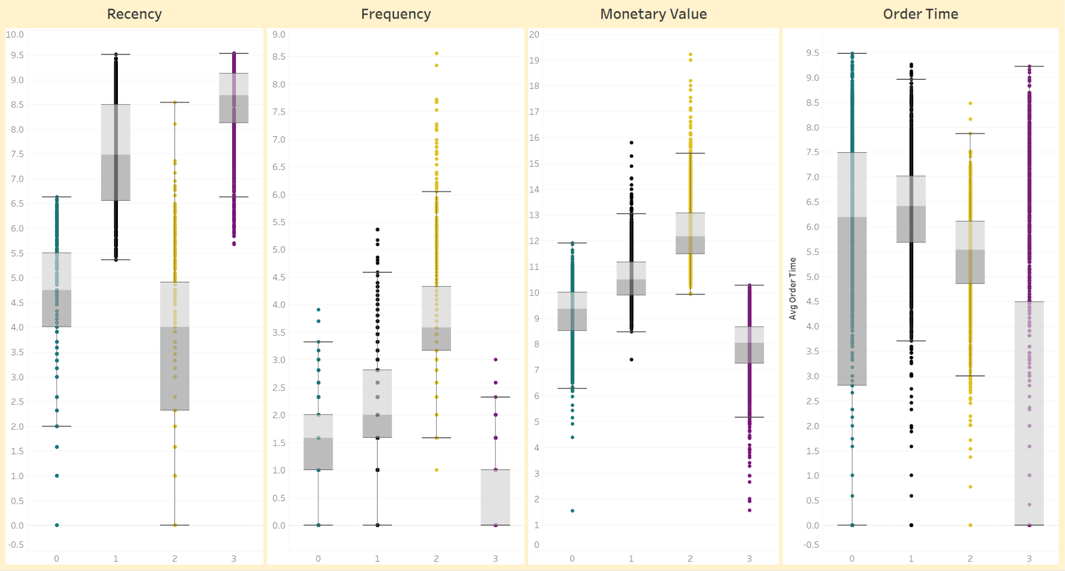
RFM
New/At Risk
Old Friends
Loyal Customers
Moved On

Slide 10
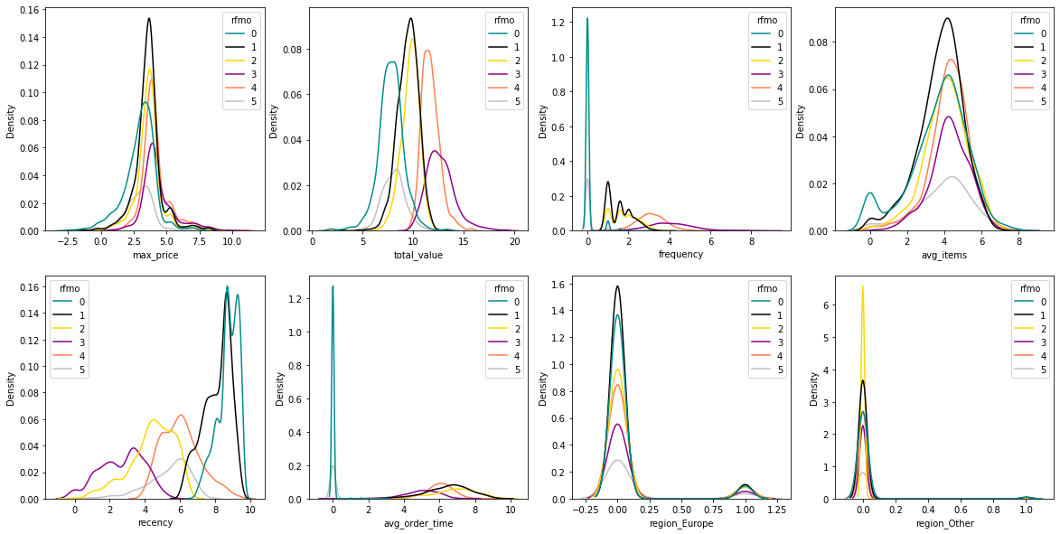
RFMO
One & Done
Moved On
At Risk
Loyal Customers
Old Friends
One & At Risk
Notes:
The case for keeping Order Time: emphasizes that we can’t know much about customers who don’t purchase regularly. We might be able to reach out to the Moved Ons, but probably not the One & Dones. This model makes a distinction between teal, which is almost certainly lost causes, and gray, which we might be able to convert to repeat buyers by incentivizing their return. Note also the yellow (At Risk) group, which has particularly slow order time - perhaps we can convert them to loyal customers by strategizing timing of incentives to get them to make more frequent orders.

Slide 11
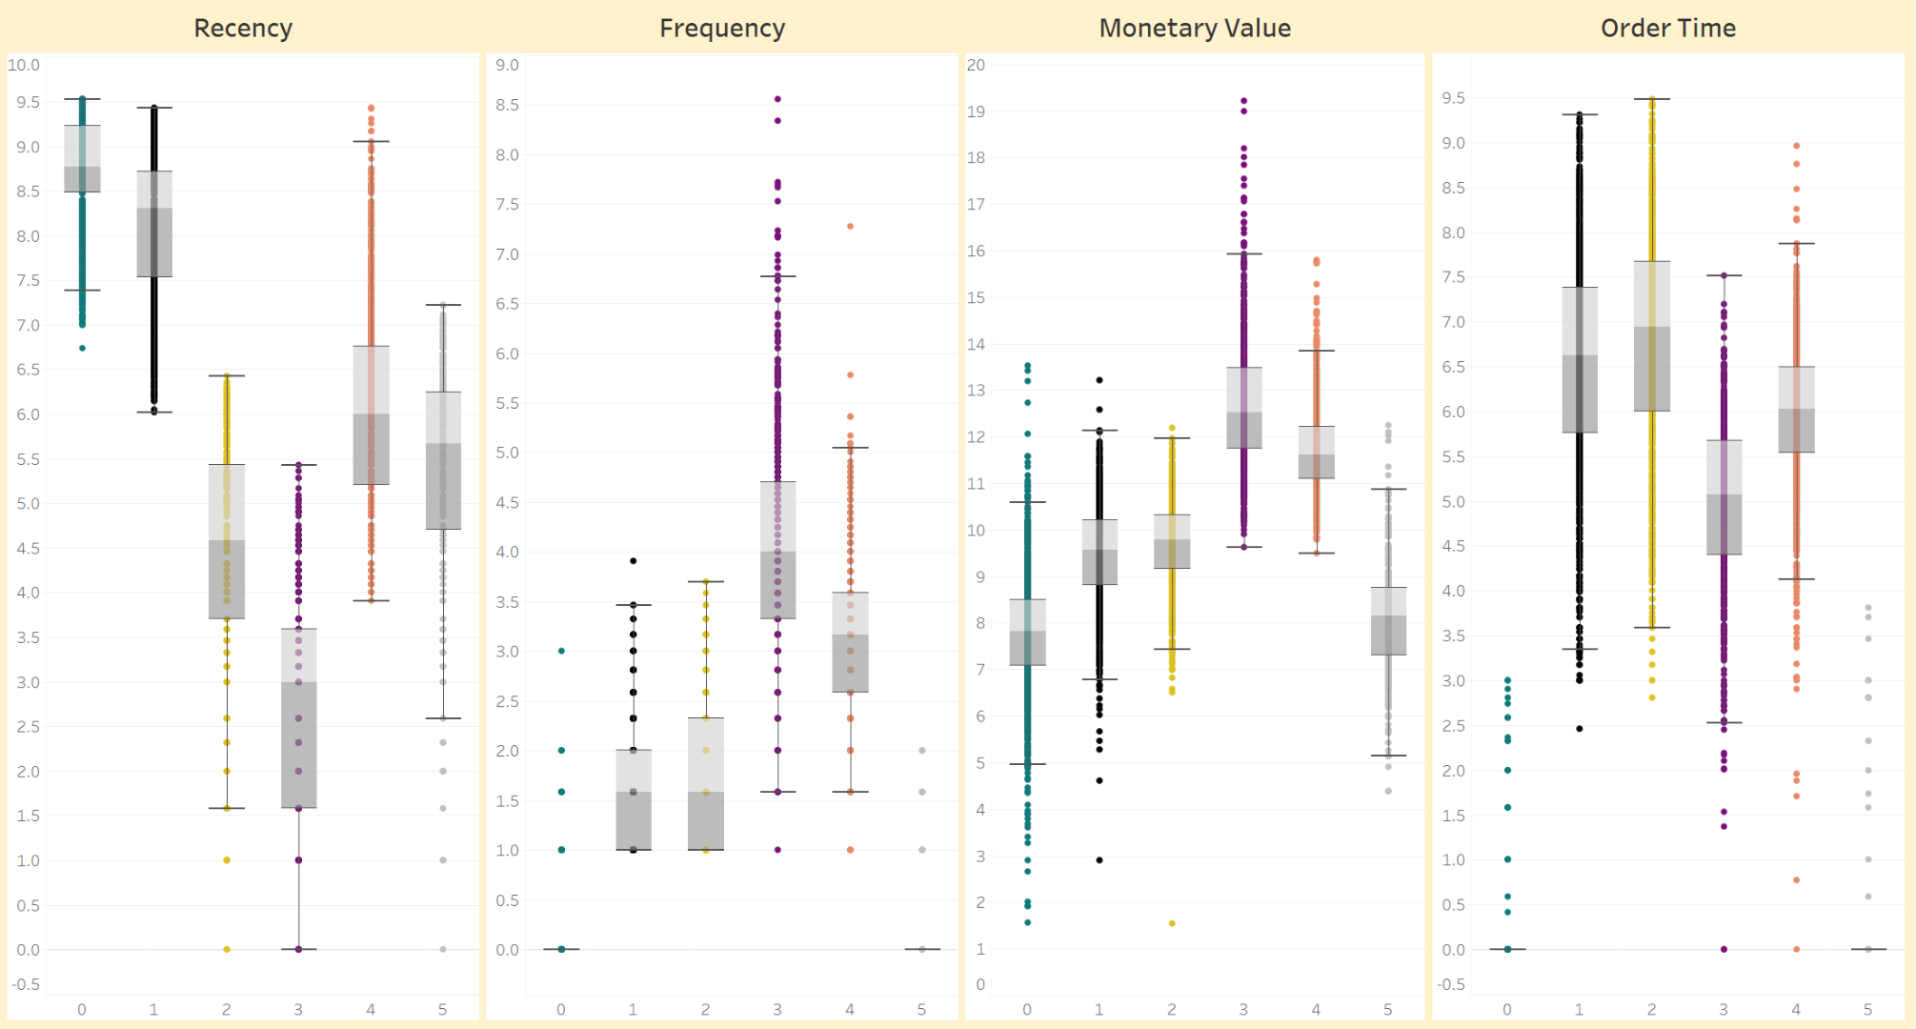
RFMO
One & Done
Moved On
At Risk
Loyal Customers
Old Friends
One & At Risk

Slide 12
Targeting our Segments
One & Done
Highlight new products, offer discount/gift for return
One & At Risk
Ask for feedback on satisfaction, offer discount/gift, target frequently
Moved On
Ask for feedback on satisfaction, highlight new products
At Risk
Offer member benefits, highlight specific products, target more frequently
Old Friends
Offer member benefits, highlight new products
Loyal Customers
Offer member benefits, referral bonuses
Notes:
Now that we have some specific characteristics of different customer segments, we can brainstorm strategies to target each group, with the goal of increasing revenue.
Example suggestions might include email campaigns or targeted advertising. Asking for satisfaction feedback could reveal customer service issues that have caused lapsed customers to stop making purchases.

Slide 13
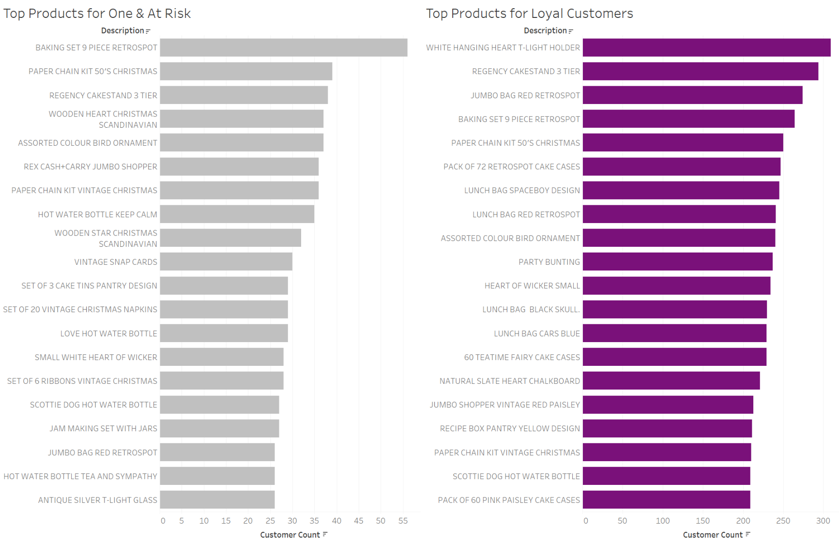
Notes:
Example of choosing which products to highlight. The Gray segment have made a purchase, but we want to ensure they will keep coming back. We can emphasize some of the products popular among our most loyal customers

Slide 14
Next Steps
Future Steps
Continue brainstorming and development of targeted strategies based on found segments
Choose a plan and develop new marketing materials
Implement plan - possibly with A/B testing within each segment
Monitor results
Ensure investment in products for most desired customers
Establish desired timeline to review changes to observed segments - next year?
Expand data collection on customers - demographic information can help market to new customers
Use labeled data to develop a supervised predictive model indicating which new customers will be the most valuable

Slide 15
Q & A

